Slide 1
Lamb to The Slaughter

Slide 2
Introducing

Slide 3
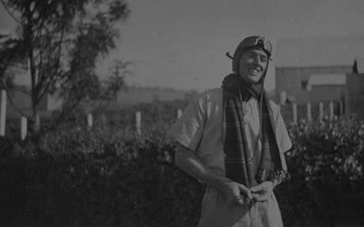
Born in 1916
Llandaff, Cardiff. United Kingdom.
5 children: 4 daughters and a son.
He was a Hurricane fighter pilot in WW2.

Slide 4
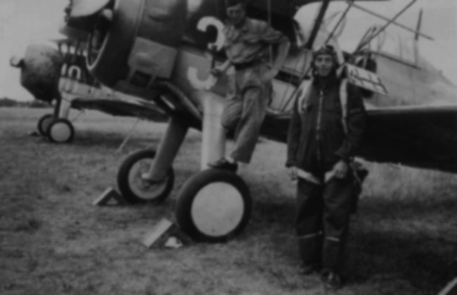
He was a cheeky boy and he was often ‘hit’ for being so.
He then graduated from Repton in 1932.
In 1939 he joined the Royal Air Force.

Slide 5
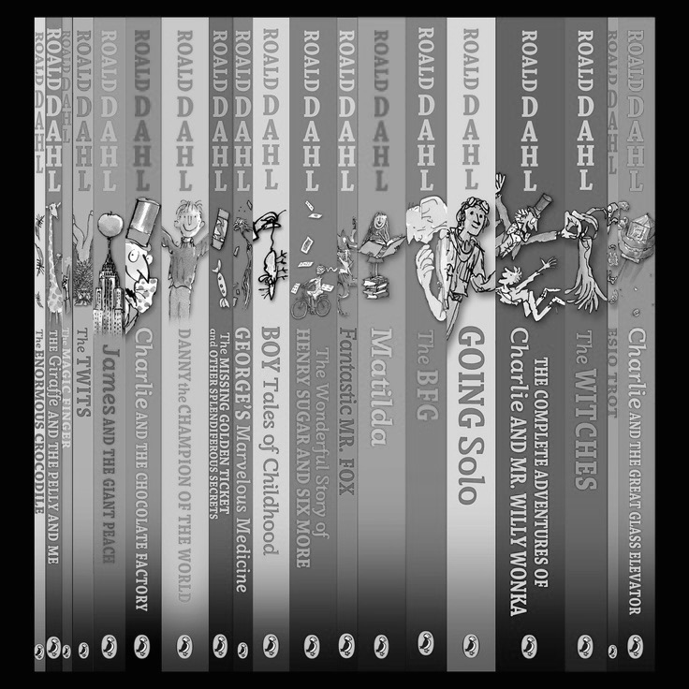
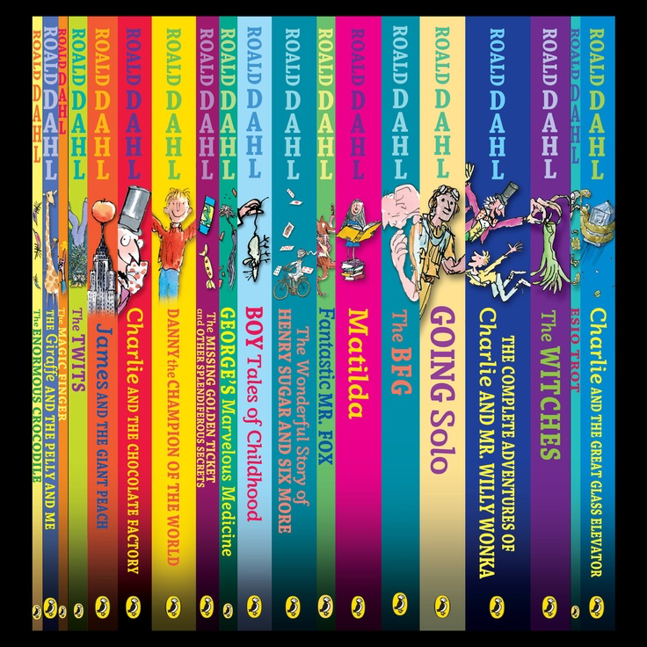
He crash-landed in Alexandria, Egypt.
Around 1953 he wrote 19 children's books.
He died on November 23, 1990, in Oxford, England.

Slide 6
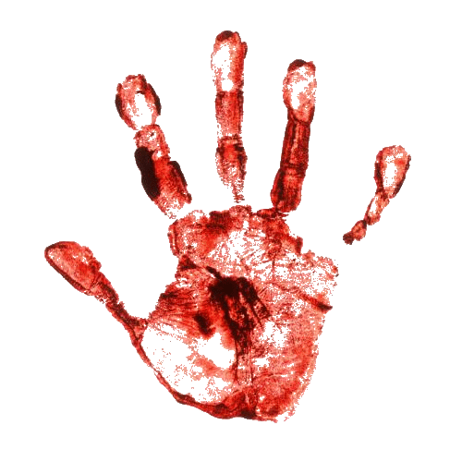
Characters: Mary Maloney Patrick Maloney Police/Detective/Doctors/Photographers Sam (Grocer)

Slide 7
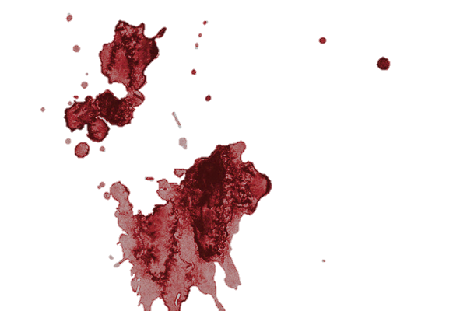
Setting
Mary & Patrick’s house
5:00PM
Clean house and curtains drawn.
America in 1950s

Slide 8
Genre:
Crime Fiction and Horror

Slide 9
Theme
Over looking people’s true nature. Judging them by what they appear to be instead of how they actually are inside.

Slide 10
Summary
Notes:
Mary Maloney waits for her husband to come home.
When he’s home from work, he’s a bit uptight and strange.

Slide 11
Notes:
He doesn’t want dinner and forces Mary to sit down.
The reader can sense that something is wrong and a conflict might start very soon.

Slide 12
Notes:
The conflict starts and Patrick (Mary’s husband) tells Mary that he needs to leave her with her baby.
He promises to send money and make sure she’s taken care of.
Mary is in shock and walks to the fridge to get Patrick dinner because there’s nothing else she could do, she was still in shock.
She realises that she’s extremely mad and so she takes a leg of lamb out of the fridge and swings it right onto Patrick’s neck

Slide 13
Notes:
Patrick is killed instantly.
Mary quickly runs up stairs and thinks about a plan. She practices talking to herself in order to talk to Sam who’s a grocer.
She meets Sam and buys vegetables using an excuse that the vegetables are for Patrick who’s hungry at home.

Slide 14
Notes:
She gets home with the vegetables and acts as if she discovers Patrick being dead on the floor.
She calls the police and doctor, informing them that she found him dead while coming back from buying vegetables from Sam

Slide 15
Notes:
The police ask her questions and they investigate for so long,
Mary thinks of another plan and asks the police if they’re hungry because she’ll cook them the leg of lamb.
The reader can sense that Mary is trying to destroy her murder weapon.

Slide 16
Notes:
The police officers and doctors are hungry so they eat the lamb.
One of the police says that the murder weapon must be a metal club and it would not be easy to hide. It must be right under their noses which means that it could have been right where they were which was in the house. But actually the murder weapon is really right under their noses.

Slide 17
Conflict:
Patrick saying that he will leave Mary, she’s in shock and can’t control her emotions. So she kills him.

Slide 18
What we learned from the story:
People who seems weak are often underestimated.
Mary is the person who Patrick over looked and so by that the author swapped the roles and made Mary the stronger individual by the end of the story.

Slide 19
A&E Television Networks, 2015
http://www.biography.com/people/roald-dahl-9264648
Comic strip by Rebecca Nicolson
http://bitstrips.com/r/J3SW1
Bibliography

